Slide 1


Start Smart 1.0
2nd Grade
Lesson 8

Slide 2

ELD Objective
ELD Objective: Students will be able to engage in a Constructive Conversation using the Constructive Conversation Skill of FORTIFY, by taking turns, sharing ideas and making ideas clearer with a partner based on a visual text.

Slide 3
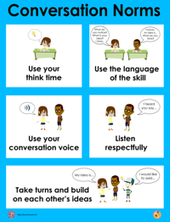
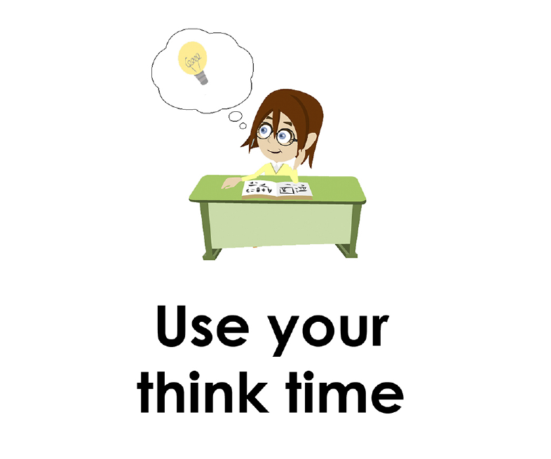
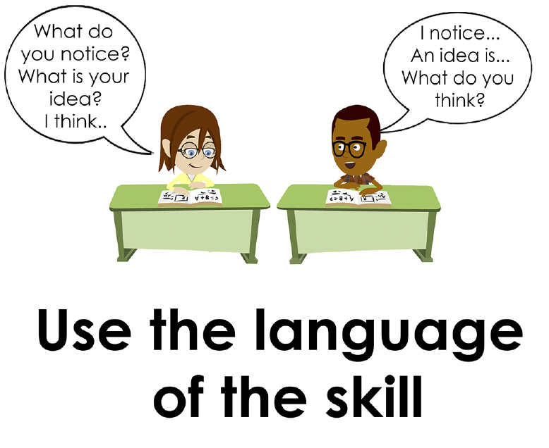
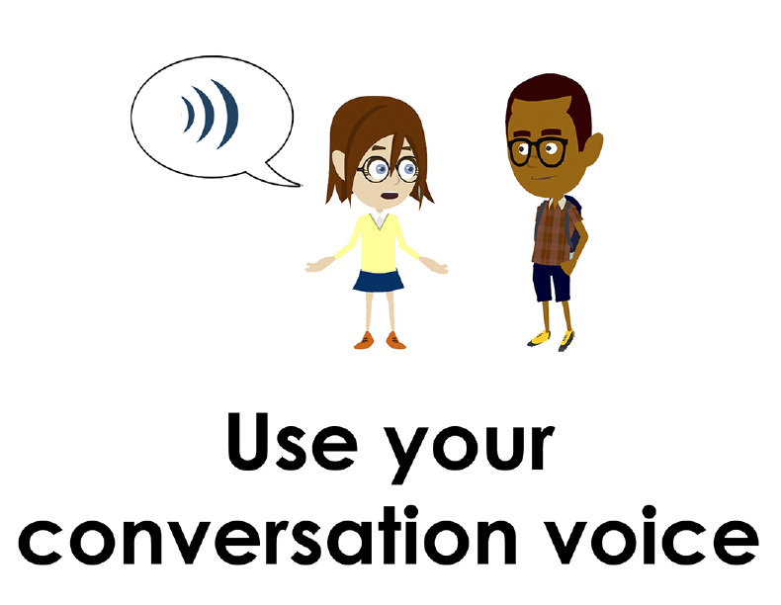
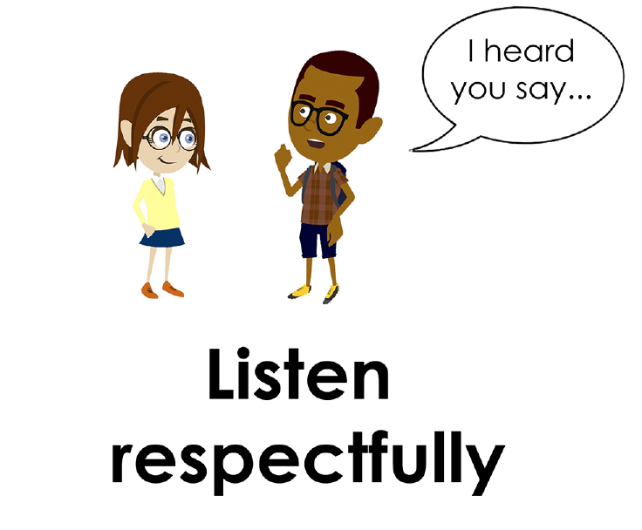
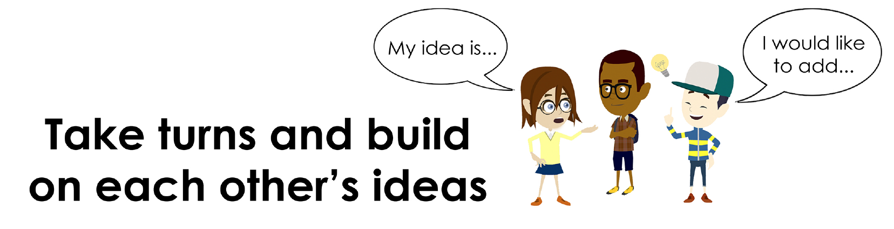
Conversation Norms Poster
  Use your think time
  Use the language of the skill
  Use your conversation voice
  Listen respectfully
  Take turns and build on each other’s ideas

Slide 4
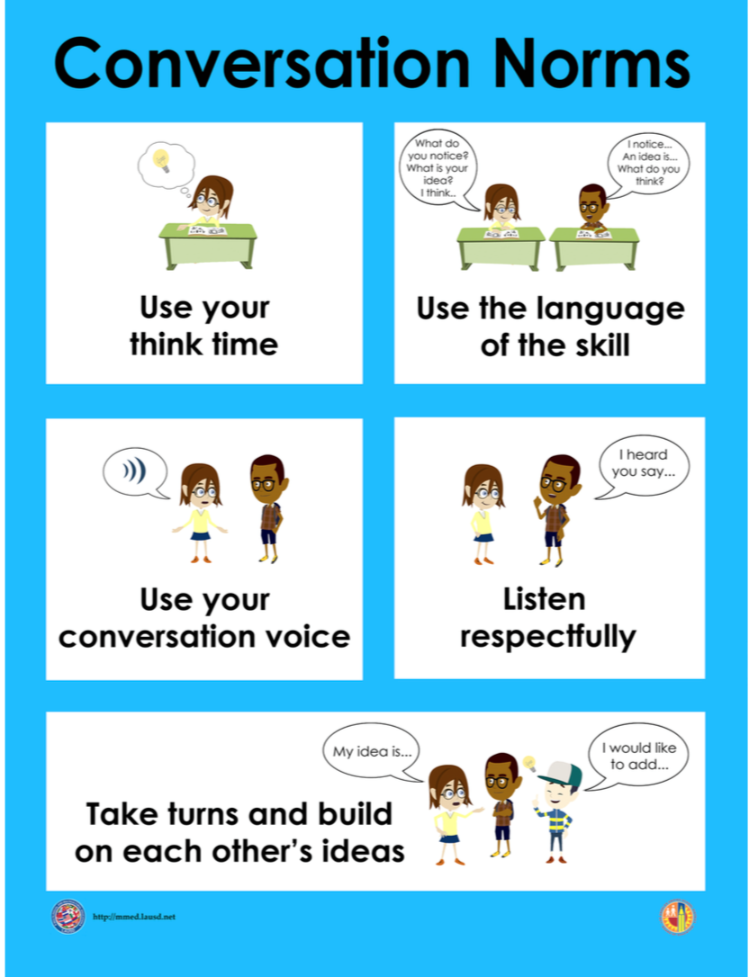
Notes:
The focus today is:
Use your think time
Use the language of the skill

Slide 5
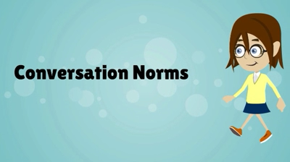
Conversation Norms
Notes:
Show Constructive Conversation Norms Video as a review of all norms

Slide 6
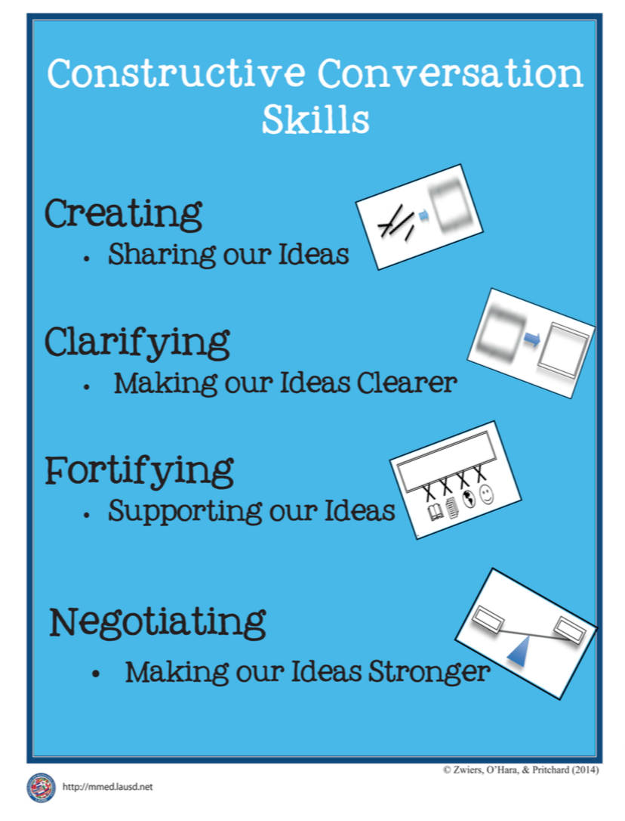
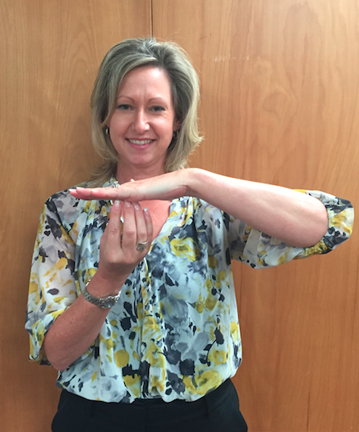
Hand Gesture and Phrase- FORTIFY
Supporting Our Ideas
Notes:
Model FORTIFY and have participants repeat with you:
Place hand, palm down in front of you as if putting an idea on the table. Use four fingertips of the other hand to support the palm.

Slide 8
Prompt:
What is happening in this visual text? Provide evidence from the text to support your claim.
TEACHER VISUAL TEXT

Slide 9


Listen to the Model Constructive Conversation
  Use your think time to study the visual text.
Listen actively to what two partners say to each other.
Notes:
Provide a copy of the Model Script to the volunteer and allow time beforehand for student to review the script. Suggestions for reading the script:
● Show a video of students having the model conversation (optional)
● Student volunteer and teacher read model script
STUDENT LISTEN ACTIVELY

Slide 10
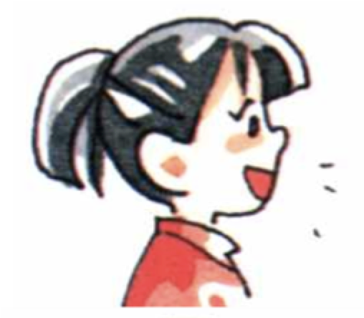
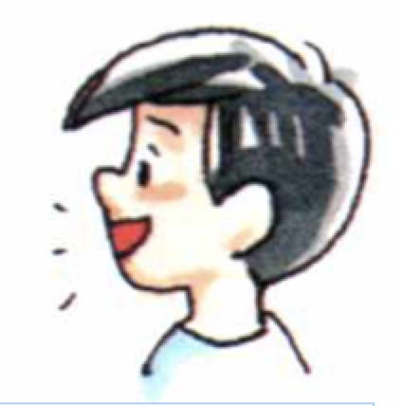
Visual Text Model
What is an important idea from this text? Start by stating your claim. Support your claim and come to a consensus.
Partner A: I think what is happening is men in a factory are building cars. What do you think is happening in the visual text?
Partner A: I notice that the man is lifting the bottom part of a car and putting a pipe on it. One man is holding a steering wheel. Another man is carrying a steering wheel. What evidence can you use to support your claim?
Partner A: I notice that the men are putting the steering wheels on the cars in the back of the picture. In the front, a man has a hammer. I think he is hammering on the wheel. What can you add to your claim?
Partner A: I think what is happening is men in a factory are building cars on an assembly line. What do you think is happening in the visual text?
Partner B: I think what is happening is that people are watching workers build a car. What can you add to your claim?
Partner B: I notice that the people are standing behind a small wall. They are wearing dress up clothes even though they are in a factory. They are looking at the workers. What evidence can you use to support your
claim?
Partner B: I notice that there are two boys hanging over the wall looking in the direction of the workers. I think that they are trying to get a closer look
at the workers building the cars. Now what do you think is happening
in the visual text?
Partner B: I think what is happening is that the dressed up people are on a tour of the car factory.

Slide 12
Listen to the Non-Model Constructive Conversation
  Use your think time to study the visual text.
Listen actively to what two partners say to each other.
Notes:
Provide a copy of the Non-­‐‑Model Script to the volunteer and allow time beforehand for student to review the script. Suggestions for reading the script:
● Show a video of students having the model conversation (optional)
● Student volunteer and teacher read model script
STUDENT LISTEN ACTIVELY

Slide 13
Visual Text Non- Model
What is an important idea from this text? Start by stating your claim. Support your claim and come to a consensus.
Partner A: The men build cars.
Partner A: A man is holding a steering wheel.
Partner A: The man has a hammer. He is hammering on the wheel. What can you add to your claim?
Partner A: There is an assembly line. What do you think is happening in the visual text?
Partner B: People watch workers.
Partner B: People are standing even though they are in a factory.
Partner B: There are two boys hanging looking at the cars. Now what do you think is happening in the visual text?
Partner B: There are dressed up people are on a tour.

Slide 14

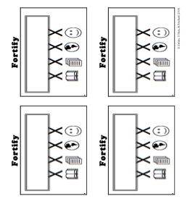
Constructive Conversation Game
PROMPT:
What is happening in this visual text? Provide evidence from the text to support your claim.
Rules of the game:
Each of you needs one CREATE, two CLARIFY and two FORTIFY cards
Each of you will play one card as you share your CREATE, CLARIFY and FORTIFY ideas. You will continue taking turns until all cards are placed in the middle.
If you’re done early repeat the process for an additional round.
Remember to use the Constructive Conversation Norms and Skills as you play the game.
Notes:
You are now going to have the opportunity to practice the Constructive Conversation Skill FORTIFY while playing a game.
Explain the rules of the Constructive Conversation Game to students.

Slide 15

Prompt: What is happening in this visual text? Provide evidence from the text to support your claim.
TEACHER COLLECTS LANGUAGE SAMPLE SPF 1.0
STUDENT VISUAL TEXT
Notes:
Display the Student Visual Text
Direct students to use their Think Time
As the students play the game, the teacher listens and selects two students who will replay the game in front of the class to serve as models.
This is an opportunity to capture a language sample.

Slide 16


CONSTRUCTIVE CONVERSATION
FISHBOWL MODEL
PROMPT: What is happening in this visual text. Provide evidence from the text to support your claim.
Listen actively to what two partners say to each other.
FORMATIVE ASSESSMENT– TEACHER COLLECTS LANGUAGE SAMPLE SPF 1.0
Notes:
The two selected students will replay the game in front of the class and serve as models.
Student Progress Form (SPF)-­‐‑ Constructive Conversation Language Sample The teacher will collect a language sample from the two students on the Student Progress Form (SPF)-­‐‑ Constructive Conversation Language Sample to be used in Lesson 2. The language sample must be at least four turns in length. (Each turn includes both Partner A and B sharing

Slide 17
WRAP-UP
How did we meet today’s objective of using the Constructive Conversation Skill of FORTIFY?
How did you:
    Use your think time?
    Use the language of the skill
  Work with your conversation partner to do the following:
    Identify three things that you did to meet today’s objective
    Share and explain the three things to your partner
Notes:
Teacher will review ELD objective.
Today we engaged in a Constructive Conversation using the Constructive Conversation Skill-­‐‑FORTIFY. We took turns and shared ideas based on a visual text.
Teacher will ask students the following:
● How did we meet today’s objective of using the Constructive Conversation Skill of FORTIFY?
● How did you:
-Use your think time
-Use the language of the skill
● Work with your conversation partner to do the following:
Identify three things that you did to meet today’s objective
Share and explain the three things to your partner
Teacher calls on three students and they tell the class what was done today.

Slide 18
Start Smart 1.0
FORTIFY
2nd Grade
Lesson 9

Slide 19
ELD Objective
Students will be able to revise a Non-Model Conversation for the Constructive Conversation Skill- FORTIFY in a whole group setting and with a triad.
Notes:
Today we are going to review the Constructive Conversation Skill-­‐‑FORTIFY. When we create, we say what we notice about something.

Slide 20
Notes:
Let’s review the Conversation Norms Poster
Today, we will focus on:
Use the language of the skill
Use your conversation voice
**Give examples for both. Ask for student volunteers to model the two norms.

Slide 21
Conversation Norms
Notes:
Show Constructive Conversation Norms Video as a review of all norms

Slide 22
Hand Gesture and Phrase- FORTIFY
Supporting Our Ideas
Notes:
Model FORTIFY and have participants repeat with you:
Place hand, palm down in front of you as if putting an idea on the table. Use four fingertips of the other hand to support the palm.

Slide 23
Prompt and Response Starters
Prompt Starters:
How do you know…?
What is happening…?
Where did you get that information?
Show me in the text where…
Response Starters:
I know because…
I think ____, so____...
I have seen this in…
In the text…

Slide 25
Prompt:
What is happening in this visual text? Provide evidence from the text to support your claim.
TEACHER VISUAL TEXT
Notes:
Display the Student Visual Text
Direct students to use their Think Time

Slide 26
Listen to the Model Constructive Conversation
  Use your think time to study the visual text.
Listen actively to what two partners say to each other.
Notes:
Provide a copy of the Model Script to the volunteer and allow time beforehand for student to review the script. Suggestions for reading the script:
● Show a video of students having the model conversation (optional)
● Student volunteer and teacher read model script
STUDENT LISTEN ACTIVELY

Slide 27
What makes this a model conversation?
Partner A: I think what is happening is men in a factory are building cars. What do you think is happening in the visual text?
Partner A: I notice that the man is lifting the bottom part of a car and putting a pipe on it. One man is holding a steering wheel. Another man is carrying a steering wheel. What evidence can you use to support your claim?
Partner A: I notice that the men are putting the steering wheels on the cars in the back of the picture. In the front, a man has a hammer. I think he is hammering on the wheel. What can you add to your claim?
Partner A: I think what is happening is men in a factory are building cars on an assembly line. What do you think is happening in the visual text?
Partner B: I think what is happening is that people are watching workers build a car. What can you add to your claim?
Partner B: I notice that the people are standing behind a small wall. They are wearing dress up clothes even though they are in a factory. They are looking at the workers. What evidence can you use to support your claim?
Partner B: I notice that there are two boys hanging over the wall looking in the direction of the workers. I think that they are trying to get a closer look
at the workers building the cars. Now what do you think is happening
in the visual text?
Partner B: I think what is happening is that the dressed up people are on a tour of the car factory.

Slide 28
Understanding the Skill of FORTIFY
Partner A: I think what is happening is men in a factory are building cars. What do you think is happening in the visual text?
Partner A: I notice that the man is lifting the bottom part of a car and putting a pipe on it. One man is holding a steering wheel. Another man is carrying a steering wheel. What evidence can you use to support your claim?
Partner A: I notice that the men are putting the steering wheels on the cars in the back of the picture. In the front, a man has a hammer. I think he is hammering on the wheel. What can you add to your claim?
Partner A: I think what is happening is men in a factory are building cars on an assembly line. What do you think is happening in the visual text?
Partner B: I think what is happening is that people are watching workers build a car. What can you add to your claim?
Partner B: I notice that the people are standing behind a small wall. They are wearing dress up clothes even though they are in a factory. They are looking at the workers. What evidence can you use to support your claim?
Partner B: I notice that there are two boys hanging over the wall looking in the direction of the workers. I think that they are trying to get a closer look
at the workers building the cars. Now what do you think is happening
in the visual text?
Partner B: I think what is happening is that the dressed up people are on a tour of the car factory.
Notes:
Understanding the Skill: Fortify
Teacher displays or distributes the Model Script from Lesson 8.
Let’s look at the Model Script to find evidence of the skills of CREATE, CLARIFY and FORTIFY. How are we using the visual text to guide our conversation?
Example of Think-Aloud:
Student A:
I notice that the man is lifting the bottom part of a car and putting a pipe on it. F One man is holding a steering wheel. F Another man is carrying a steering wheel. F What evidence can you use to support your claim? F
Student B:
I notice that the people are standing behind a small wall. F They are wearing dress up clothes even though they are in a factory. They are looking at the workers. F What evidence can you use to support your claim? F
Student A:
I notice that the men are putting the steering wheels on the cars in the back of the picture. F In the front, a man has a hammer. I think he is hammering on the wheel. F What can you add to your claim? F
Let’s look at the first set of turns. Read it to yourself as I read it aloud (see example above).
Let’s look at the language of the skill. Look at Student A’s response. How do I know Student A used the skill of FORTIFY? I notice the language of the skill (underline as noted above).
I know this is FORTIFY because it is asking for evidence from the text so I will label it with F (Write F next to the response.) I also notice that Student B is using the language of the skill to answer a FORTIFY question to provide evidence, so I will label it with F (Write F next to the response and underline as noted above). Student A responds with the language of the skill FORTIFY (underline as noted above). Also, they provide more evidence, based on what is in the visual text.
Teacher prompts student pairs to go through the same process with the rest of the Model Conversation. Students may share their responses in a whole group discussion led by the teacher.

Slide 30
Listen to the Non-Model Constructive Conversation
  Use your think time to study the visual text.
Listen actively to what two partners say to each other.
WHAT DO YOU NOTICE IN THE VISUAL TEXT? CITE DETAILS TO CLARIFY YOUR IDEAS.
Notes:
Provide a copy of the Non-Model Script to the volunteer and allow time beforehand for student to review the script. Suggestions for reading the script:
● Show a video of students having the model conversation (optional)
● Student volunteer and teacher read model script
STUDENT LISTEN ACTIVELY
STUDENTS SHOULD LISTEN ACTIVELY

Slide 31
Visual Text Non- Model
What is an important idea from this text? Start by stating your claim. Support your claim and come to a consensus.
Partner A: The men build cars.
Partner A: A man is holding a steering wheel.
Partner A: The man has a hammer. He is hammering on the wheel. What can you add to your claim?
Partner A: There is an assembly line. What do you think is happening in the visual text?
Partner B: People watch workers.
Partner B: People are standing even though they are in a factory.
Partner B: There are two boys hanging looking at the cars. Now what do you think is happening in the visual text?
Partner B: There are dressed up people are on a tour.
Notes:
Review Non-Model
Teacher displays or distributes the Non-Model Script from Lesson 8.
Let’s look at the Non-Model Script. How can we improve this Constructive Conversation? This was our prompt, “What is happening in this visual text? Provide evidence from the text to support your claim.” Read it to yourself as I read it aloud. Think about the prompt and the language of the Constructive Conversation Skill FORTIFY.
Teacher will use questions and the Listening Task Poster to guide students through an analysis of what makes this a Non-Model Constructive Conversation for the skill of FORTIFY. See possible responses below.
No, they did not take turns sharing their ideas because partner A spoke two times in a row, without letting partner B take a turn
At first, they responded to the prompt, but towards the end they went off topic
They did not build on each other’s ideas
Teacher along with students revise the text on chart paper or document reader.
Non-Model:
Student A:
The men build cars. (not using language of the skill; not prompting other partner)
Student B:
People watch workers. (not using language of the skill; not prompting other partner)
Student A:
A man is holding a steering wheel. (not using language of the skill; not prompting other partner; )
Student B:
People are standing even though they are in a factory. (not using language of the skill; not prompting other partner)
Student A:
The man has a hammer. He is hammering on the wheel. What can you add to your claim? (not using language of the skill)
Student B:
There are two boys hanging looking at the cars. Now what do you think is happening in the visual text? (no prompting of the other partner)
Student A:
There is an assembly line. What do you think is happening in the visual text? (not using evidence from the text to support the idea)
Student B:
There are dressed up people are on a tour. (not using evidence from the text to support the idea)
Revised* Non-Model:
*text indicates what the teacher should cross out as the text is being revised.
Bold indicates language revised.
Student A:
I think what is happening is T the men are building cars in a factory. What do you think is happening in the visual text?
Student B:
I think what is happening is that the People are watching workers build cars. What can you add to your claim?
Student A:
I notice that A a man is holding a steering wheel. Another man is putting a pipe on the car. What evidence can you use to support your claim?
Student B:
I notice that pPeople are standing behind a wall. They are watching the workers. They are dressed up even though they are in a factory. What evidence can you use to support your claim?
Student A:
I notice that tThe man has a hammer. It looks like hHe is hammering on the wheel. The men in the back of the picture are putting on the steering wheels. What can you add to your claim?
Student B:
I notice that tThere are two boys hanging on the wall looking at the workers building cars. Now what do you think is happening in the visual text?
Student A:
I think what is happening is that men are building cars on There is an assembly line. What do you think is happening in the visual text?
Student B:
I think what is happening is that the There are dressed up people are on a factory tour.
Refer to class revised Non-Model, have pairs read.

Slide 32
REVISE
NON-MODEL
Note to Teacher: Consult pg. 39-40 of Start Smart 1.0 Lessons or Teacher Resources at end of
Power point
WHOLE-GROUP/CLASS REVISED NON-MODEL
Notes:
Teacher along with students revise the text on chart paper or document reader.
Revised* Non-Model:
*text indicates what the teacher should cross out as the text is being revised.
Bold indicates language revised.
Student A:
I think what is happening is T the men are building cars in a factory. What do you think is happening in the visual text?
Student B:
I think what is happening is that the People are watching workers build cars. What can you add to your claim?
Student A:
I notice that A a man is holding a steering wheel. Another man is putting a pipe on the car. What evidence can you use to support your claim?
Student B:
I notice that pPeople are standing behind a wall. They are watching the workers. They are dressed up even though they are in a factory. What evidence can you use to support your claim?
Student A:
I notice that tThe man has a hammer. It looks like hHe is hammering on the wheel. The men in the back of the picture are putting on the steering wheels. What can you add to your claim?
Student B:
I notice that tThere are two boys hanging on the wall looking at the workers building cars. Now what do you think is happening in the visual text?
Student A:
I think what is happening is that men are building cars on There is an assembly line. What do you think is happening in the visual text?
Student B:
I think what is happening is that the There are dressed up people are on a factory tour.
Refer to class revised Non-Model, have pairs read.

Slide 33
Prompt:
What is happening in this visual text? Provide evidence from the text to support your claim.
Notes:
Display the Student Visual Text
Direct students to use their Think Time

Slide 34

Language Sample Revision-Non-Model
You will work in a triad:
Number off from 1-3 to form a triad and select a student who will record the revision of the language sample
Read the language sample
Orally revise the language sample to improve the conversation
Use the prompt and response starters for FORTIFY
Be prepared to share out to the class
FORMATIVE ASSESSMENT– TEACHER COLLECTS LANGUAGE SAMPLE SPF 1.0
Notes:
Teacher will review ELD objective.
Today we revised a FORTIFY Non-­‐‑Model Constructive Conversation. We took turns and shared ideas based on a visual text.
Teacher asks students the following:
● How did we meet today’s objective of using the Constructive Conversation Skill of FORTIFY?
● How did you:
o use the language of the skill o use your conversation voice
● Work with your conversation partner to do the following:
o Identify three things that you did to meet today’s objective o Share and explain the three things to your partner
Teacher calls on three students and they tell the class what was done today.

Slide 35
WRAP-UP
How did we meet today’s objective of using the Constructive Conversation Skill of FORTIFY?
How did you:
    Use the language of the skill?
    Use your conversation voice?
Work with your conversation partner to do the following:
    Identify three things that you did to meet today’s objective
    Share and explain the three things to your partner

Slide 36
Start Smart 1.0
FORTIFY
2nd GRADE
Lesson 10

Slide 37
ELD Objective
ELD Objective: Students will be able to engage in a Constructive Conversation using the Constructive Conversation Skill of FORTIFY, by sharing ideas and taking turns based on a visual text with a partner.
Notes:
Today we are going to practice the Constructive Conversation Skill FORTIFY. When we observe or read something new we have many thoughts and ideas. As we engage in a FORTIFY conversation, our job as speakers is to create and take ownership of our ideas. As listeners our role is to value and foster them same or different ideas we hear.

Slide 38
Notes:
Let’s chorally read the Conversation Norms Poster.
Use your think time
Use the language of the skill
Use your conversation voice
Listen respectfully
Take turns and build on each other’s ideas
Today, we will focus on:
Listen respectfully
Take turns and build on each other’s ideas

Slide 39
Conversation Norms
Notes:
Show Constructive Conversation Norms Video as a review of all norms

Slide 41
Prompt:
What is happening in this visual text? Provide evidence from the text to support your claim.
TEACHER VISUAL TEXT
Notes:
Display the Student Visual Text
Direct students to use their Think Time

Slide 42
Listen to the Model Constructive Conversation
  Use your think time to study the visual text.
Listen actively to what two partners say to each other.
Notes:
Provide a copy of the Model Script to the volunteer and allow time beforehand for student to review the script. Suggestions for reading the script:
● Show a video of students having the model conversation (optional)
● Model with a student using the Model Script.

Slide 43
Visual Text Model
What is happening in this visual text. Provide evidence from the text to support your claim.
Partner A: I think what is happening is the man and his horse are bringing the children a library. What do you think is happening in the visual text?
Partner A:I notice that the man’s horse is carrying a shelf on its back. The shelves are full of books. It looks like he is talking to the little boy while he waits. What evidence can you use to support your claim?
Partner A: I notice that the older kids are reading large books like the ones on the man’s horse. What can you add to your claim?
Partner A: I think what is happening is the librarian is bringing the older F children books from his library on horseback. What do you think is happening in the visual text?
Partner B: I think what is happening is that the children are enjoying reading books together. What can you add to your claim?
Partner B:I notice that there are older kids reading. Two boys are leaning together reading a book. One boy is pointing to something in the book. They look like they are focusing on the book. What evidence can you use to support your claim?
Partner B: I notice that the three girls in the back are looking at a book, too. Two are reading together and one is reading a large book by herself. Now what do you think is happening in the visual text?
Partner B: I think what is happening is that the older children are enjoying reading by sharing the library books.

Slide 45
Listen to the Non-Model Constructive Conversation
  Use your think time to study the visual text.
Listen actively to what two partners say to each other.
Notes:
Provide a copy of the Non-Model Script to the volunteer and allow time beforehand for student to review the script. Suggestions for reading the script:
● Show a video of students having the model conversation (optional)
● Model with a student using the Non-Model Script.

Slide 46
Visual Text Non- Model
What is happening in this visual text. Provide evidence from the text to support your claim.
Partner A: The man and his horse are bringing the children something. What’s happening?
Partner A: I notice that the man’s horse. What evidence can you use to support your claim?
Partner A: They are reading large books.
Partner A: The librarian has a library on horseback. What’s happening?
Partner B: The children like to read. What can you add?
Partner B: They look like they are focusing on the book. What evidence can you use to support your claim?
Partner B: I notice that there are three girls in the back. Now what is happening?
Partner B: Older children enjoy reading.

Slide 47
Constructive Conversation Game
PROMPT:
What is happening in this visual text? Provide evidence from the text to support your claim.
Rules of the game:
Each of you needs one CREATE, two CLARIFY and two FORTIFY cards
Each of you will play one card as you share your CREATE, CLARIFY and FORTIFY ideas. You will continue taking turns until all cards are placed in the middle.
If you’re done early repeat the process for an additional round.
Remember to use the Constructive Conversation Norms and Skills as you play the game.
Notes:
You are now going to have the opportunity to practice the Constructive Conversation Skill FORTIFY while playing a game.
Explain the rules of the Constructive Conversation Game to students.

Slide 48
Prompt: What is happening in this visual text? Provide evidence from the text to support your claim.
TEACHER COLLECTS LANGUAGE SAMPLE SPF 1.0
STUDENT VISUAL TEXT
Notes:
Display the Student Visual Text
Direct students to use their Think Time
As the students play the game, the teacher listens and selects two students who will replay the game in front of the class to serve as models.
This is an opportunity to capture a language sample.

Slide 49
CONSTRUCTIVE CONVERSATION
FISHBOWL MODEL
PROMPT: What is happening in this visual text. Provide evidence from the text to support your claim.
Listen actively to what two partners say to each other.
FORMATIVE ASSESSMENT– TEACHER COLLECTS LANGUAGE SAMPLE SPF 1.0
Notes:
The two selected students will replay the game in front of the class and serve as models.
Student Progress Form (SPF)-­‐‑ Constructive Conversation Language Sample The teacher will collect a language sample from the two students on the Student Progress Form (SPF)-­‐‑ Constructive Conversation Language Sample to be used in Lesson 2. The language sample must be at least four turns in length. (Each turn includes both Partner A and B sharing

Slide 50
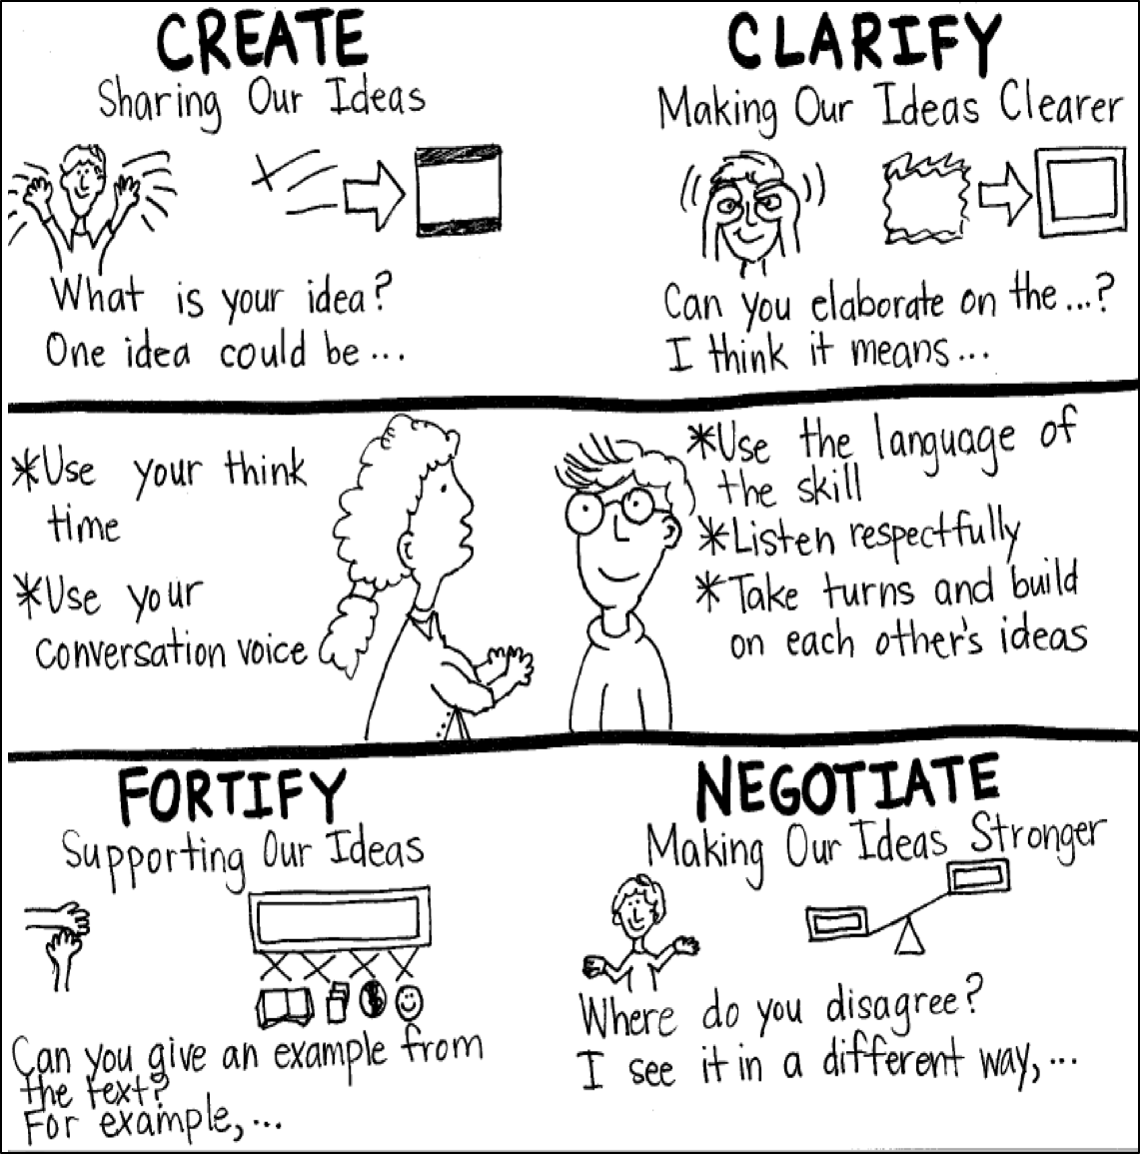
Model Creating Class Constructive Conversation Poster
Sample
Notes:
Teacher models creating a Constructive Conversation Poster. This slide is a resource. Teacher elicits student responses to help student develop a poster that illustrates their understanding of the FORTIFY skill and conversation norms.

Slide 51
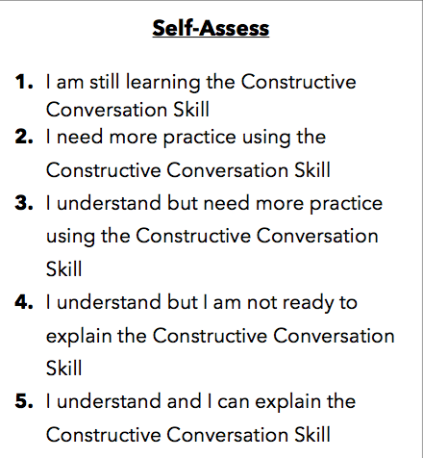
Notes:
Teacher will review the Constructive Conversation Skill FORTIFY
Students will self-assess answering the prompt
Teacher may select a conversation pair to share out.
EXAMPLE:
Student: I rated myself a 3 because…
Teacher: What can you do to move to a 4?

Slide 52
Teacher Resources

Slide 53
FORTIFY Non-Model Revision

